Slide 1
St Benedict’s Catholic Primary School
Year 5 – Summer 2 - 2024
Creativity | In Y5, we celebrate difference: differences in ourselves, in our approaches, in the work we produce and the choices we make. We welcome new experiences and use these to develop our own creativity. Our creativity is encouraged across the curriculum – from writing to music, from dance to drawing and our learning platform provides even more opportunities to develop and share this creativity both in school and at home.
Independence | In Y5, we are developing independence in our work, our play and our attitude. We use our developing skills to rely less on others and use our own initiative to find the best way to solve challenges. We learn to organise our time and resources and take responsibility to work towards our own targets. As individuals, we realise the importance of making our own choices and taking responsibility for these. ​
Resilience | In Y5, we are not afraid to take chances and we support each other when we face difficult challenges. We understand that the path to success involves some ups and downs and that we cannot succeed all the time. We know it is ok to make mistakes. We openly share our mistakes to help each other get better and this builds confidence and resilience. We actively talk about and discuss times when we can be resilient, and we celebrate this quality in each other as we see it grow.​
Vocabulary | In Y5, language is key to the way we communicate with each other. We love experimenting with language and are always searching for new words which we share and celebrate with each other. We understand the power of language to convey our emotions to better understand each other. This filters through into our work where we constantly strive to raise standards and our relationships beyond the classroom.​
In the light of Jesus, we learn to shine.

Slide 2
St Benedict’s Catholic Primary School
RELIGIOUS EDUCATION | FREEDOM AND RESPONSIBILITY Christians believe that God has given to each person the free will and power to choose. The gift of God’s Spirit, guarantee of God’s abiding presence is the foundation of Christian faith in the holiness of conscience. The creative interplay of freedom and responsibility informs the life of the community of believers, the Church.
 | Explore | EXPLORE Freedom involves responsibility
 | Reveal | REVEAL God’s rules for living freely and responsibly – the Commandments
 | Respond | RESPOND: Acquire the skills of assimilation, celebration and application of the above. | Vocabulary: freedom, responsibility, Beatitudes, Commandments
RELIGIOUS EDUCATION | STEWARDSHIP Christians believe that the diversity of the world and its people is God’s gift. Jesus in his life and gospel, challenges people to appreciate diversity and to create with it a harmony that reflects the unity of Father, Son and Holy Spirit. This is reflected in the work of CAFOD. We ourselves are part of creation, and are dependent upon it: we are made aware that caring for creation is part of caring for ourselves.
 | Explore | EXPLORE Caring for the Earth by thinking about how we look after the things we care for in our own lives.
 | Reveal | REVEAL The Church is called to Stewardship of Creation by exploring and appreciating the Wonder of nature and the world around us.
 | Respond | RESPOND : Remembering, celebrating and responding to caring for the Earth and that the Church is called to stewardship of Creation | Vocabulary: care, world, Earth, sustainable, stewards, stewardship sustainable, creation, creator, created, stewards stewardship, climate, preserve, ecology, integrity harmony
In the light of Jesus, we learn to shine.

Slide 3
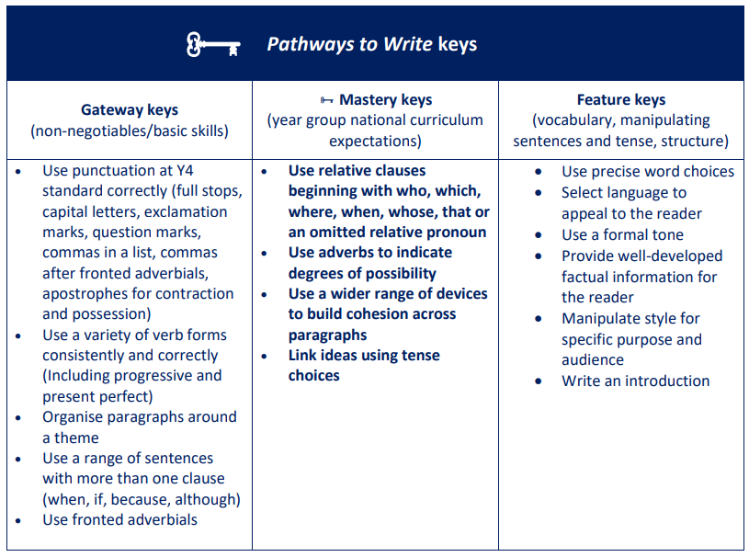
St Benedict’s Catholic Primary School
ENGLISH | READING | Follow Reading for Mastery format to focus on key skills : text talk, word detectives, rapid retrieval, inference and deduction, text evaluation.
 | WRITING
 | Grammar and Spelling | Spelling Review Y3/4 HF spelling lists. Unstressed vowels in polysyllabic words ( definite, desperate) Verb prefixes de- and re- (deflate, recycle…) Prefix over- (overthrow, overslept, overcook…) Convert nouns or verbs to adjectives by adding the suffix –ful (boastful, doubtful, faithful…) Convert nouns or verbs to adjectives by adding the suffix –ive (attractive, creative, appreciative …) Convert nouns or verbs to adjectives by adding the suffix –al (musical, political, accidental…) | Link ideas across paragraphs using adverbials of time [for example, later], place [for example, nearby] and number [for example, secondly] or tense choices [for example, he had seen her before] Verb prefixes [for example, dis–, de–, mis–, over– and re– Converting nouns or adjectives into verbs using suffixes [for example, – ate; –ise; – ify]
MATHS | SHAPE – DECIMALS BLOCK (cont.) Step 6 Add decimals with different numbers of decimal places Step 7 Subtract decimals with different number of decimal places Step 8 Efficient strategies for adding and subtracting decimals Step 9 Decimal sequences NEGATIVE NUMBERS Step 1 Understand negative numbers Step 2 Count through zero in 1s Step 3 Count through zero in multiples Step 4 Compare and order negative numbers Step 5 Find the difference CONVERTING UNITS Step 1 Kilograms and kilometres Step 2 Millimetres and millilitres Step 3 Convert units of length Step 4 Convert between metric and imperial units Step 5 Convert units of time Step 6 Calculate with timetables VOLUME Step 1 Cubic centimetres Step 2 Compare volume Step 3 Estimate volume Step 4 Estimate capacity
In the light of Jesus, we learn to shine.

Slide 4
St Benedict’s Catholic Primary School
SCIENCE | Working Scientifically Planning different scientific enquiries to answer questions, incl. variables Taking measurements with scientific equipment Recording data using various graphs, keys, tables, diagrams Use test results to set up further tests and comparative tests Recording and presenting findings, incl. conclusions, degrees of trust Identify where evidence has been used to support or refute ideas FORCES Explain that unsupported objects fall towards the Earth because of the force of Gravity acting between the Earth and the falling object. Identify the effects of air resistance, water resistance and friction that act between moving surfaces. Recognise that some mechanisms, including levers, pulleys and gears, allow a smaller force to have a greater effect. Vocabulary Gravity Earth Air resistance Water resistance Friction Forces
Computing | DB Primary online platform Programming: Quizzical Quiz: 6,7, 8 Information tech: robotics fact file E-Safety: viruses Fact files E- Safety Fact file, crossword and quiz. Vocabulary E safety; robotics; viruses
History | Human and physical geography I know that the first layer of the Earth’s atmosphere is called the troposphere and that it is here that weather occurs. I can use data to create a graph showing the hottest and coldest inhabited places on Earth, before comparing them. I can explain what a drought is and some of the causes and effects. I can explain why some areas get more rain than others in relation to the water cycle. I can describe some extreme weather phenomena around the world, including tornados, tropical storms, hail storms and blizzards. I can describe the effects of extreme weather phenomena on the environment and people affected. I can use plate tectonics to describe what earthquakes are and why they happen. I know what the Richter scale is. I can describe the effects of earthquakes on the environment and people affected. I know that tsunamis occur when there are earthquakes on the ocean floor. I can describe what happens when a volcano erupts. Locational knowledge • I know where some places of extreme temperature are located.
Geography | Geography was taught in Summer One
In the light of Jesus, we learn to shine.

Slide 5
St Benedict’s Catholic Primary School
LANGUAGES | FRENCH Going to the seaside / Beach activities / Getting ready to go on holidays I can: use a modal verb (you can and infinitive) give opinions about activities at the beach say what you can/like to play at the beach say what you can/like to eat and drink at the beach say what you can/like to wear at the beach
MUSIC | Focus on melody and the accompaniment . I can perform longer note values accurately. I can read and perform notes covering a whole octave. I can play shorter note values accurately. I can play a part that is different to those around me. I can stay in time. I can play along in time with a backing track. Rehearsal for our performance . Performance | Vocabulary Posture Breathing Technical Structure Rhythm Melody Octave
PSHE | To show knowledge and understanding of the physical changes and puberty. (Journey in love) To celebrate the joy of growing physically and spiritually. Health and Wellbeing Growing and changing Personal identity; recognising individuality and different qualities; mental wellbeing Keeping safe Keeping safe in different situations, including responding in emergencies, first aid. | Vocabulary Puberty Hormones Development Health Well-being Safety Emergency
PHYSICAL EDUCATION | ATHLETICS Understand the benefits of physical exercise and the importance of warming up and cooling down. To develop techniques in sprinting. To build stamina. To develop techniques for running and jumping over hurdles. To use developing techniques adapted for relay races. To change direction efficiently. To develop throwing techniques linked to shot put / discus. To develop technique for jumping over distance. (Long jump) Compete in a mini triathlon comprising of skills from the athletics unit. | Vocabulary Warm up Cool down Performance Communicate Collaborate Competitive Pace Targets Athletics Refine Compare Improve
DT | Fashion and Textiles Use research and develop design criteria to inform the design of innovative, functional, appealing products that are fit for purpose, aimed at particular individuals or groups generate, develop, model and communicate their ideas through discussion, annotated sketches, cross-sectional and exploded diagrams, prototypes, pattern pieces and computer-aided design select from and use a wider range of tools and equipment to perform practical tasks [for example, cutting, shaping, joining and finishing], accurately select from and use a wider range of materials and components, including construction materials, textiles and ingredients, according to their functional properties and aesthetic qualities investigate and analyse a range of existing products evaluate their ideas and products against their own design criteria and consider the views of others to improve their work | Vocabulary Research Design Criteria Diagram Sketch Annotate Aesthetic
ENRICHMENT | High School Transition Day at Cardinal Newman High School Discovery Day at St Gregory’s High School Sports Day Summer Fayre UseUse CENTURY software to follow a unique, fluid learning pathway in SPaG Maths and Science Use READING PLUS to develop reading and vocabulary skills.
ART | Art was taught in Summer 1
In the light of Jesus, we learn to shine.

